Slide 1
Lecture 1
Introduction
J. G. Weisend II
R. Dhuley
G. Tatkowski
USPAS
February 2025

Slide 2
Class Goals
Provide the basics of Cryogenic Engineering
  At the end of the class students should:
    Be familiar with principles and common practices of cryogenic engineering
    Be able to perform basic analysis and design
    Possess a solid foundation for further study in the field
    Be able to understand the issues and concerns of experts in the field, particularly in an accelerator environment
Use real world examples mainly from accelerator labs
  Stress will be on large scale Helium systems
Be interesting. None of us started in this profession to be bored – Cryogenics, we hope to show is an interesting application of engineering

Slide 3
Who We Are : John Weisend
Currently, Senior Accelerator Engineer at the European Spallation Source, Lund, Sweden & Adjunct Prof. Lund University
Previous work at:
  Michigan State University
  National Science Foundation
  Stanford Linear Accelerator Center (SLAC)
  DESY Lab, Hamburg, Germany
  Centre d’Etudes Nucleaires, Grenoble, France
  SSC Laboratory
PhD and MS from University of Wisconsin – Madison
BSME from University of Miami
Interests: Large scale cryogenics, writing, education, cryogenic safety, instrumentation & organization of large international scientific projects

Slide 4
Who We Are : Ram Dhuley
Currently, Staff Engineer in Fermilab’s Applied Physics and Superconducting Technology Division (APS-TD)
Previous work:
  Postdoc at National High Magnetic Field Laboratory, Tallahassee, Florida, US
  Design engineer at General Electric, Bangalore, India
  Visiting researcher at Queen Mary University of London, UK
PhD in Mech. Eng. from Florida State University, US
BS and MS in Mech Eng. From Indian Institute of Technology Bombay (IIT Bombay), India
Interests:
  Cryogenic system design, cryocoolers, instrumentation
  Technical writing, education/teaching

Slide 5
Who We Are : Greg Tatkowski
Currently, Senior Cryogenics Engineer and Department Manager at the SQMS Center at Fermilab
Registered Professional Engineer in State of Illinois
Previous work:
  Design cryogenics engineer for SuperCDMS, Mu2e and E1039 experiments at Fermilab
  Review chair for Fermilab’s SBND experiment
  Product engineer at vertically integrated electric heater manufacturer in Illinois
Bachelors & Master Degrees from Illinois Institute of Technology in Mechanical Engineering
Interests:
  Dilution refrigerators

Slide 6
Evaluation
Problem Sets 70%
Design Project 30%

Slide 7
Resources
Class slides
Textbook Cryogenic Systems by R. Barron (2nd Edition)
List of Suggested Additional Reading
Ask lots of questions!
  During class
  During the week
  After the class is finished
  Instructors contact information
  Ram Dhuley -rdhuley@fnal.gov
  John Weisend - john.weisend@ess.eu

Slide 8
What is Cryogenics?
Cryogenics is the science & engineering of phenomena that occur
at temperatures below 120 K

Slide 9
Why 120 K?
The temperature below which
“permanent gases” start to condense
Fluid | Normal Boiling Point (K)
Krypton | 119.8
Methane | 111.6
Oxygen | 90.2
Argon | 87.3
Nitrogen | 77.4
Neon | 27.1
Hydrogen | 20.3
Helium | 4.2

Slide 10
Cryogenics & Accelerators
Cryogenics plays a major role in modern particle accelerators
  Enables superconductivity
    Beam bending and focusing magnets (1.8 K – 4.5 K)
    Magnets for particle identification in large detectors (4.2 – 4.5 K)
    Superconducting RF cavities for particle acceleration (1.8 K – 4.2 K)
  Allows dense pure liquids
    LAr calorimeters (87 K)
    LH₂ targets, moderators and absorbers (20 K)
  Provides sub-Kelvin cooling for certain types of dark matter searches
Since the Tevatron (1983) accelerator cryogenic systems have become larger, more reliable, more efficient, industrialized and much more widespread

Slide 11
Cryogenics & Accelerators
Accelerator requirements have played a significant role in pushing cryogenic technology
  Automated, efficient & reliable large scale Helium refrigeration plants
  Development & industrialization of cold compressors
  Studies on He II two-phase flow
  Radiation resistant cryogenic temperature sensors
  Production of reliable high field superconducting magnets
    MRI has also had a significant impact here
  Production of high gradient SRF cavities

Slide 12
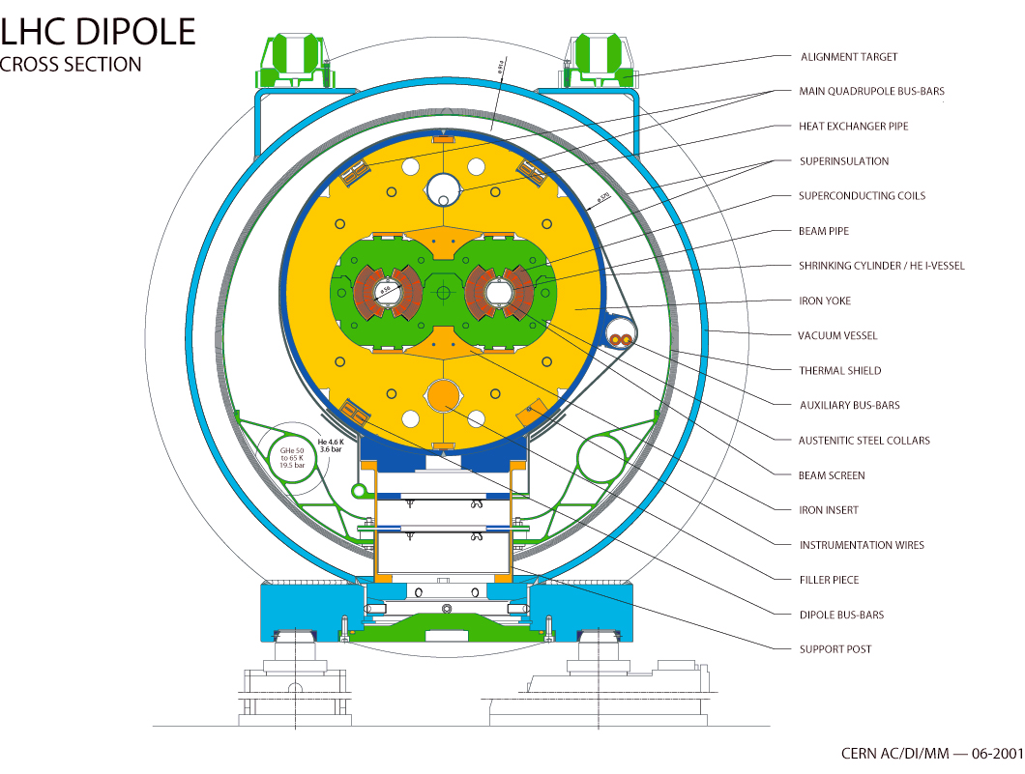
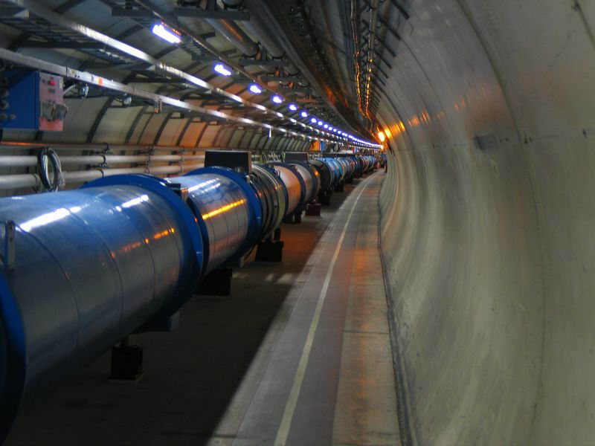
Superconductivity
(enables high field magnets)
Large Hadron Collider (CERN) 9 T magnets operating at 1.8 K (superfluid helium)

Slide 13
Superconducting RF is Very Popular
Name | Location | Purpose | Status (as of June 2023) | Comments
LCLS II | USA | FEL Driver | Commissioning | TESLA Technology
XFEL | Germany | FEL Driver | Operating | TESLA Technology
FLASH | Germany | FEL Driver | Operating | TESLA Technology
SHINE | China | FEL Driver | Under Construction | TESLA Technology
S³FEL | China | FEL Driver | Under construction | TESLA Technology
DALS | China | FEL Driver | Proposed | TESLA Technology
CEBAF | USA | Electron Linac for Nuclear Science | Operating
SNS | USA | Proton Driver for a spallation neutron source | Operating
ESS | Sweden | Proton Linac for a spallation neutron source | Commissioning
PIP II | USA | Proton Linac for high energy physics | Under Construction
FRIB | USA | Heavy Ion Linac | Operating
RAON | South Korea | Heavy Ion Linac | Commissioning
ILC | Japan | Electron/Positron Collider for High Energy Physics | Proposed | TESLA Technology
S-DALINAC | Germany | FEL Driver, Nuclear Physics & Accelerator R&D | Operating | Extrapolation of TESLA Technology
CBETA | USA | Test Accelerator | Operating | TESLA Technology
MINERVA | Belgium | Proton Linac for Accelerator Driven Reactor | Under Construction
CIADS | China | Proton Linac for ADS | Under Construction

Slide 14
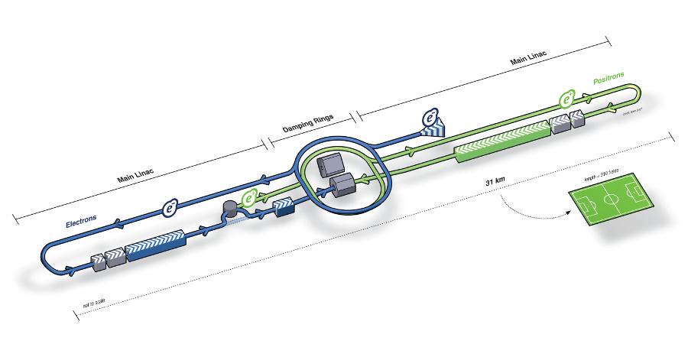
International Linear Collider
(most likely the upper limit of this approach)
e-/e+ linear collider (250 GeV on 250 GeV)
~ 2000 Cryomodules,
~ 16,000 SCRF cavities
2 K operation
10 x 20 kW (4.5 K eq) cryoplants

Slide 15
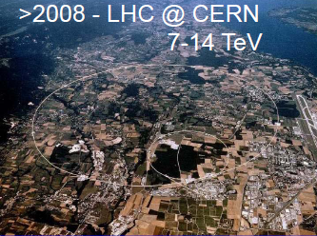
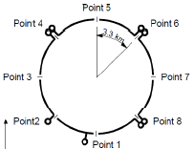
Large He Systems Have Become Common
2007 LHC
8 Plants each with 18 kW @ 4.5 K
Largest current use of He II
Each plant provides 2.4 kW @ 1.9 K
Total He inventory 120 metric tonnes
All plants were procured from industry

Slide 16
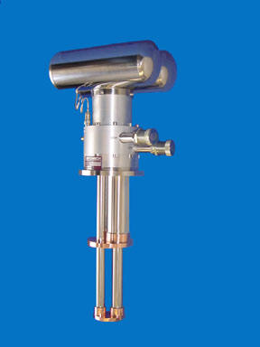
Use of Small Cryocoolers is Also Growing
CryoMech PT415
  40 W @ 45 K
  1.5 W @4.2 K
Small cryocoolers, particularly those based on pulse tube technology are becoming more reliable and commercially available. These may well play a role at various temperature levels in accelerator cryogenics
Applications may include intermediate thermal shield cooling and the development of small cryogen free magnets or SRF Cavities and the use of cryocoolers to reliquefy LHe or LH₂
The current maximum capacity of pulse tube coolers at 4.2. K is 1.5 W but devices with up to 5 W capacity are under development.
Small cryocoolers may be particularly interesting in accelerators that only have a few cryogenic devices: e.g. light sources with superconducting undulators

Slide 17
Small Cryocooler Application
Muon Ionization Cooling Experiment
A beam physics experiment in support of future muon colliders
  Contains SCRF cavities, SC magnets and LH₂ absorbers
  Extensive use of small cryocoolers to reliquefy both LHe and LH₂
  Use of cryogen free magnets is also being investigated
  Currently under design for operation at RAL

Slide 18

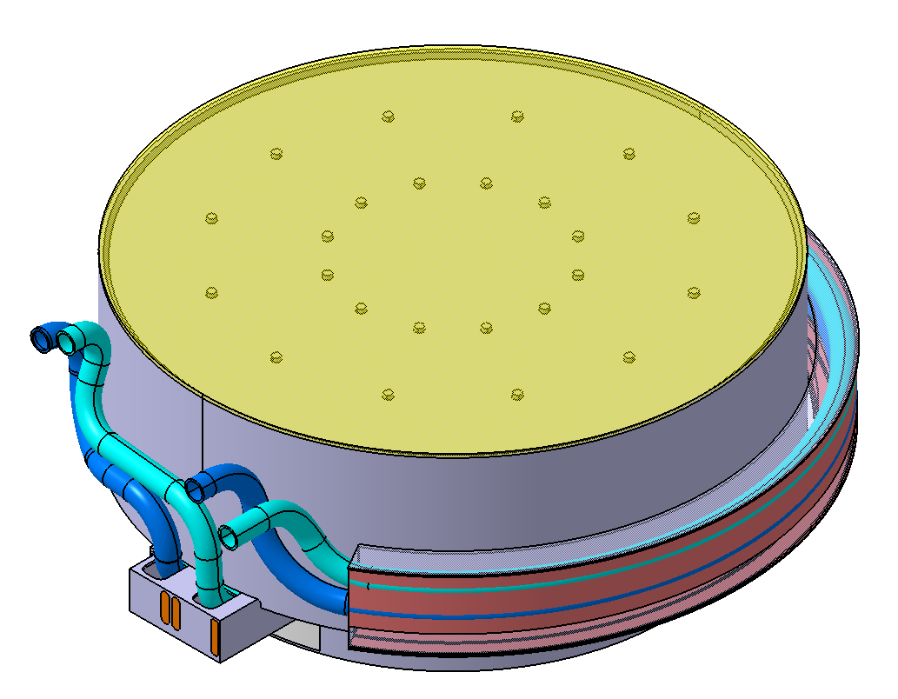
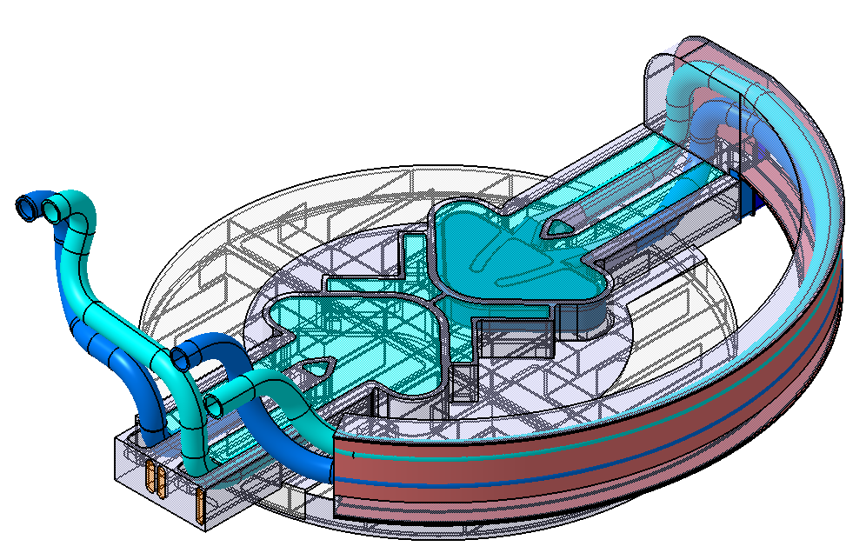
Cryogenics Provides Dense Fluids for Calorimeters, Moderators and Targets
ESS moderator & reflector unit design
Cold Butterfly moderator (LH₂)
Be-Reflector/
-vessel
Thermal moderator (water)
LH₂ pipework
20 K
30.3 kW of cooling required
Vacuum chamber (extruded profile include 2 cooling chambers for thermal moderator water

Slide 19
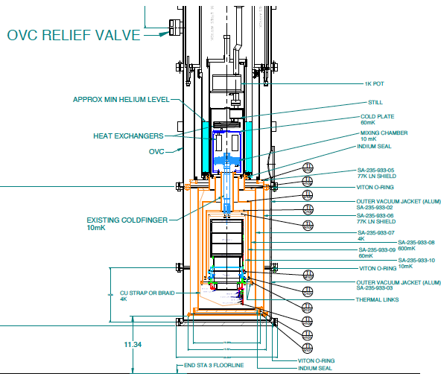
Cryogenics is Also Used in Non-Accelerator
Based Fundamental Physics
CDMS detector test stand
Dilution refrigerator
~ 20 mK operating temperature
Temperature level required for proper detector operation and low thermal background

Slide 20
Summary
Cryogenics is an important enabling technology in accelerator and fundamental physics
Cryogenic applications cover a wide range from the very small to the very large and from 120 K to μK
Cryogenics also plays a major role in astronomy, solid state physics and medicine
The study of cryogenics involves many disciplines including: thermodynamics, heat transfer, fluid mechanics, mechanical design, material science, instrumentation and quantum mechanics
There’s lots to learn
Let’s Get Started

